Slide 1
Evaluation Metrics
We can’t improve what we don’t assess

Slide 2
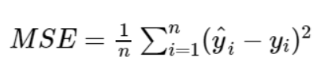
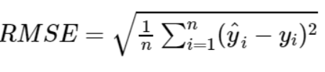

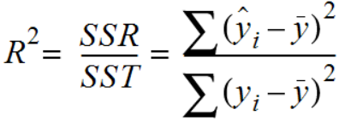
MSE ,RMSE ,MAE and R-squared
MSE (Mean Squared Error) is the most common metric for regression. It is the average of the squared difference between the predicted and actual value.
RMSE (Root Mean Squared Error) is the square root of the average of the square difference of the predicted and actual value.
MAE (Mean absolute error) is the average of the absolute difference between the target value or the value predicted by the model. This is not preferred in cases where outliers are prominent.
R-squared or coefficient of determination represents the part of the variance of the dependent variable explained by the independent variables of the model. It measures the strength of the relationship between your model and the dependent value.

Slide 3
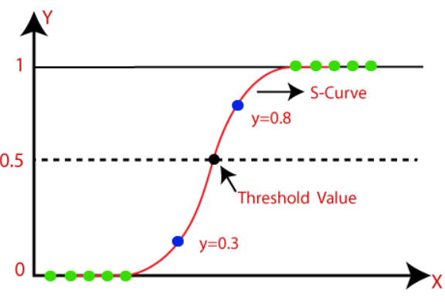
Logistic Function or Sigmoid Function
The sigmoid function is a mathematical function used to map the predicted values to probabilities.
It maps any real value into another value within a range of 0 and 1.
The value of the logistic regression must be between 0 and 1, which cannot go beyond this limit, so it forms a curve like the “S” form. This curve is called Sigmoid function or logistic function.
In logistic regression, we use the concept of the threshold value, which defines the probability of either 0 or 1. The values above the threshold tends to 1 and the values below the threshold tends to 0.

Slide 4
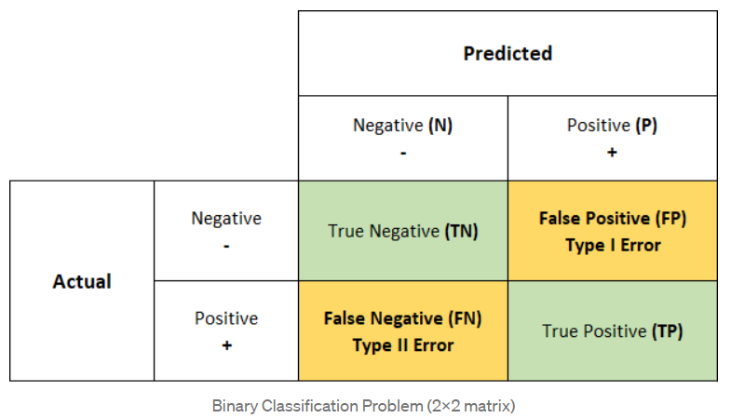
Confusion Matrix
A Confusion matrix is an N×N matrix used for evaluating the performance of a classification model, where N is the number of target classes. The matrix compares the actual target values with those predicted by machine learning model.
A confusion matrix is a tabular summary of the number of correct and incorrect predictions made by a classifier.
A good model is one which has high TP and TN rates, low FP and FN rates.
True Positives(TP): When the actual and predicted value is positive.
True Negatives(TN): When the actual and predicted value is negative.
False positives(FP): When the actual is negative but prediction is positive – Type I error
False negatives(FN): When the actual is positive but the prediction is negative – Type II error

Slide 5
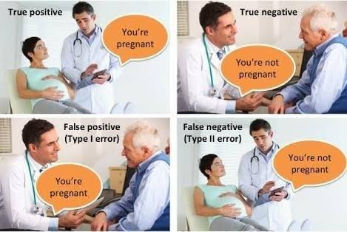
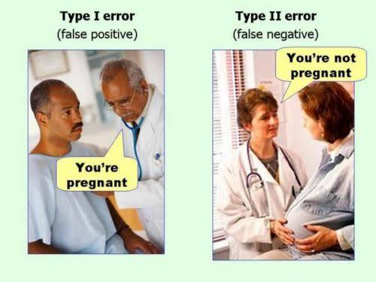

Slide 6
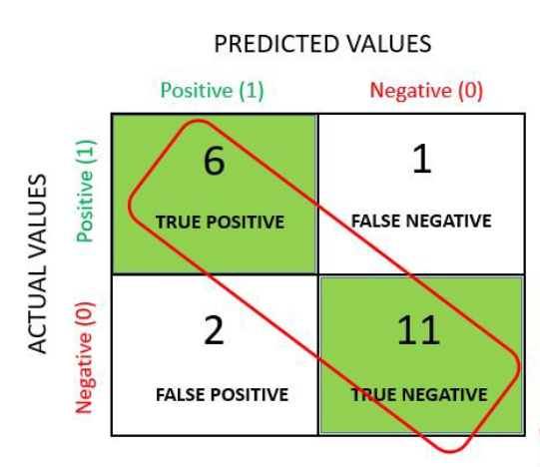
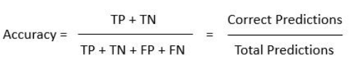
Accuracy
Accuracy simply measures how often the classifier makes the correct prediction.
It is the ratio between the number of correct predictions and the total number of predictions.
It is the measure of correctness that is achieved in true prediction. It tells you how many predictions are actually positive out of all the total positive predicted.
Accuracy is a valid choice of evaluation for classification problems which are well balanced and not skewed.
Accuracy is not suited for imbalanced classes. When the model predicts that each point belongs to the majority class label, the accuracy will be high. But, the model is not accurate.
Formula:

Slide 7
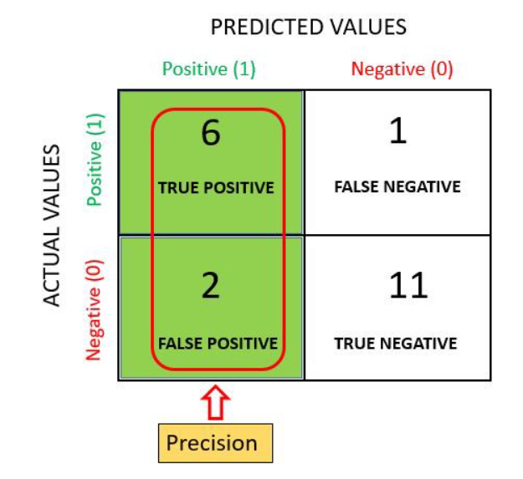

Precision
It is the measure of correctness that is achieved in true prediction. It tells us how many predictions are actually positive out of all the total positive predicted.
Precision is defined as the ratio of the total number of correctly classified positive classes divided by the total number of predicted positive classes.
In simple terms, out of all the predictive positive classes, how much did we predict correctly.
Precision should be ideally high – almost 1
Precision is a useful metric in cases where False Positive is a higher concern than False Negative. Example: Spam detection.
Formula:

Slide 8
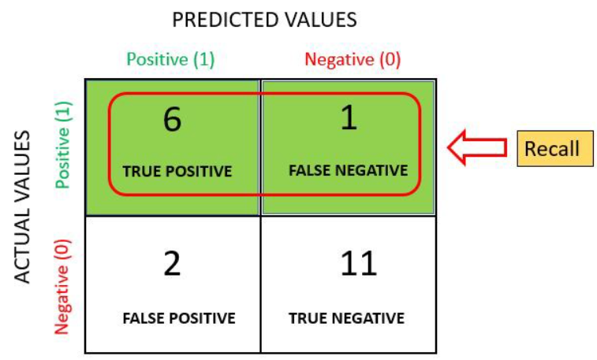

Recall or Sensitivity
Recall is the measure of actual observations that are predicted correctly i.e., how many observations of positive class are actually predicted as positive.
It is a valid choice of evaluation metric when we want to capture as many positives as possible.
Recall is defined as the ratio of the total number of correctly classified positive classes divided by the total number of positive classes.
In simple terms, out of all the positive classes, how much have we predicted correctly.
Precision is a useful metric in cases where False Negative is more than False Positive. Example: A patient suffering from cancer or not(The actual positive cases should not go undetected)
Formula:

Slide 9
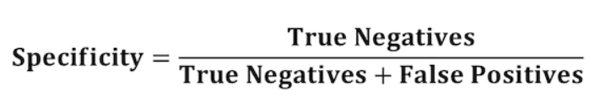
Specificity
Specificity is the measure of true negatives that are correctly identified by the model.
Specificity is defined as the ratio of the total number of correctly classified negative classes divided by the total number of negative classes.
In simple terms, out of all the negative classes, how much have we predicted correctly.
Example: Proportion of people not suffering from the disease who got predicted correctly as the ones who are not suffering from the disease. In other words, the person is healthy actually got predicted as healthy.
Formula:

Slide 10
Misclassification Rate
Misclassification rate is a metric that tells us the percentage of observations that were incorrectly predicted by some classification model.
Misclassification rate can be defined as the ratio of the total number of incorrect predictions by the total number of predictions.
The value of misclassification rate can range from 0 to 1, where, 0 represents a model that has zero incorrect predictions and 1 represents a model that had complete incorrect predictions.
Clearly, the lower the value of misclassification rate, the better a classification model is able to predict the outcomes of the response variable.
The opposite of misclassification rate is the accuracy.

Slide 11
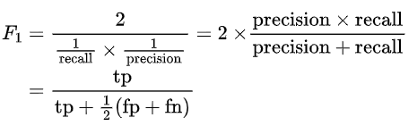

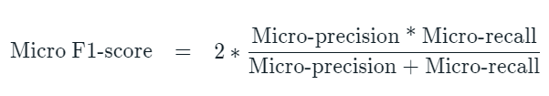
F1-Score
F1-score is an evaluation metric for classification defined as the harmonic mean of precision and recall.
It is used to evaluate binary classification systems, which classify examples into ‘positive’ or ‘negative’
The value of F-score is when it is 1 and the worst when it is 0. F-score 1 represents the perfect accuracy and recall of the model.
Formula:
Macro F1-score is used to assess the quality of problems with multiple binary labels or multiple classes.
Formula: Mean of class-wise/label-wise F1 scores
Micro F1-score is used to assess the quality of multiple binary problems.
Formula:

Slide 12
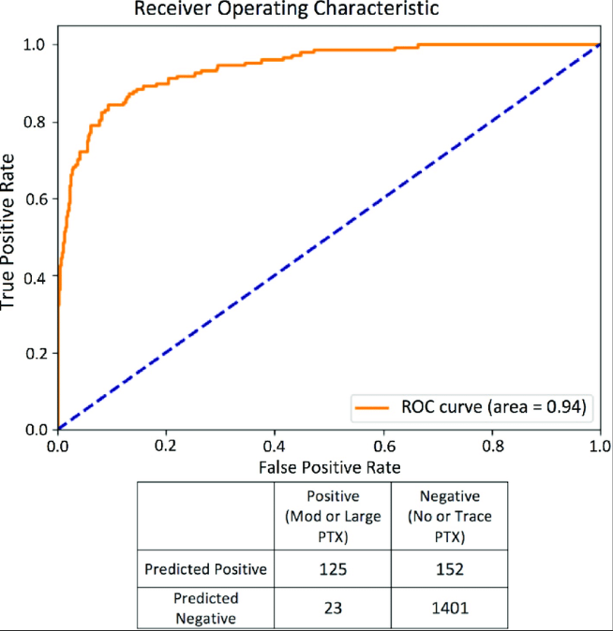

ROC-AUC curve
The ROC curve is an evaluation metric that measures the performance of a machine learning model by visualizing, especially when the data is skewed.
ROC provides a simple way to summarize the information related to different thresholds and resulting TPR(Total Positive rate) and FPR(False Positive Rate) values.
In simple terms, ROC is nothing but the plot between TPR and FPR across all thresholds.
AUC(Area Under the Curve) – A model is good when the area under the curve is maximum.
Total Positive Rate and False Positive Rate:

Slide 13
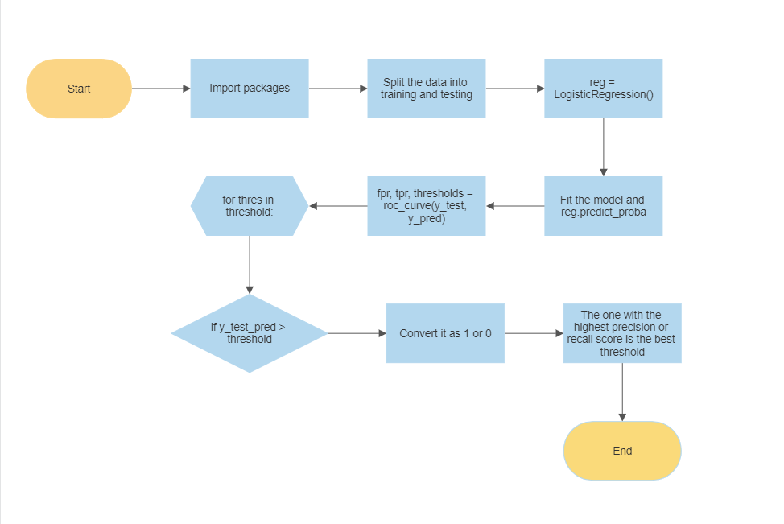
Flowchart to select the best threshold

Slide 14
THANK YOU!

